Slide 1
Behavioural Economics 871
Lecture 1: Introduction

Slide 2
Course admin
Lectures:
Wednesday: 8:30-10:30
Week 1 in Schumann Annex 1027
Week 2 to 12: TBD by Carina (probably Schumann 2nd floor)
Tutorial
Approximately 7 two-hour tutorials
Dates and venue TBD
No tutorial this week
May also use one tutorial slot for make-up class

Slide 3
Course admin
Assessment:
Exam (50%)
Essay (30%)
Three problem sets (10%) – possibly group work
Class presentations (10%) – possibly group work

Slide 4
Today’s outline
Classical economics vs. Behavioural economics
Dual-process model of cognition
Quick intro to neuro-economics

Slide 5
Reading list
DellaVigna, S., 2009. Psychology and economics: Evidence from the field. Journal of Economic Literature, 47(2): 315-72.
Cohen, J.D., 2005. The vulcanization of the human brain: A neural perspective on interactions between cognition and emotion. Journal of Economic Perspectives, 19(4): 3-24.
Thaler, R.H., 2018. From cashews to nudges: The evolution of behavioral economics. American Economic Review, 108(6): 1265-87.
Rabin, M., 2013. An approach to incorporating psychology into economics. American Economic Review, 103(3): 617-22.
Rabin, M., 2002. A perspective on psychology and economics. European Economic Review, 46(4–5): 657–85.
Stigler, G., & Becker, G., 1977. De gustibus non est disputandum. American Economic Review, 67(2): 76-90.

Slide 6
Classical economics
Economics is a social science that studies market forces and how people respond to such forces
Classical economic theories premised on notion that people behave rationally
They have (well-behaved) preferences
They process all available information appropriately
They make decisions that maximise expected welfare given constraints
These assumptions can produce very powerful and insightful models that help us understand, predict and influence human behaviour
However, such models assume that people have unlimited time and computing ability when making decisions
Notes:
Economics is a social science, like anthropology, political science and sociology; primarily interested in human behaviour.
Essence: figuring out what people care about, and what they are trying to achieve when they make decisions helps you understand, predict and influence their behaviour
Example: Economics of crime show that understanding what potential criminals are trying to achieve can: 1) help understand crime patterns (across time and space), 2) provide policy levers to curb criminal activity in most cost-effective way

Slide 7
Behavioural economics
In reality, some decisions are made when individuals are impatient, angry, distracted, hungry, drunk, etc.
Classical economics have traditionally viewed such psychological “quirks” as random errors that:
cancel out in large groups of people
disappear as people and society learn from their mistakes
are ultimately not of first order importance
However, since 1970s it has been persuasively demonstrated that some of these errors are systematically biased
Insights from psychology that explain such “errors” can be crucial to understanding important aspects of human behaviour, and may help design policies to improve welfare
Birth of new field, known as Behavioural Economics
Studies joint effect of economic and psychological factors on human decisions
More appropriate name would have been Psychology and Economics
Notes:
Or lazy or unintelligent
BE already awarded 4 Nobel Prizes.
BE a bad name because all of economics is about behaviour
Matthew Rabin: BE suggests we only care about behaviour and not welfare, which is false

Slide 8
Behavioural economics
Behavioural economics is a field of academic research that studies the joint influences of psychological and economic factors on behaviour
First wave of BE identified behavioural anomalies – ways in which economic theory is importantly wrong – and provided informal psychological explanations
Examples: Kahnemann & Tversky’s research; Richard Thaler’s Anomalies series of papers in the JEP
This wave was often critical of economic methods (rather than just assumptions), and was initially not well received by economists
Second wave formalised some of these alternative explanations into precise economic models
Also applied rigorous methods of economics (e.g. field and lab experiments, empirical analysis on large samples) to test psychology theories in context of economic questions
Third wave attempts to integrate these models into mainstream economics
Increasing realisation by economists that these insights help us extend, rather than abandon, economic models (much like game theory has done)
Notes:
First wave: annoying to economists and not very rigorous. E.g. Dictator game played by second years students in Arizona shows that most people are altruistic, so we should double minimum wages in SA.
Second wave added some theoretical and empirical rigour. Also the main distinguishing factor between BE & Psych
Third wave example: hyperbolic discounting model with partial naivete generalises model of exponential discounting with perfect self-insight.

Slide 9
Behavioural economic models
How will workers in a firm respond to R1,000 wage cut during pandemic lockdown?
Using BE to predict behavioural and welfare responses requires more than list of motivations and cognitive limitations
Overidentification problem: practically any peculiar behaviour can be rationalised ex-post with more than one behavioural anomaly
Need to know how important different factors are in specific environment
This requires models that are general and simple
De gustibus non est disputandum (Stigler & Becker 1977)
Rabin (2013) proposes generalising existing economic models to allow for psychological factors (PEEMs)
Pick unused Greek letter
Reframe existing model as specific case of more general model that allows for broader range of behaviour

Slide 10
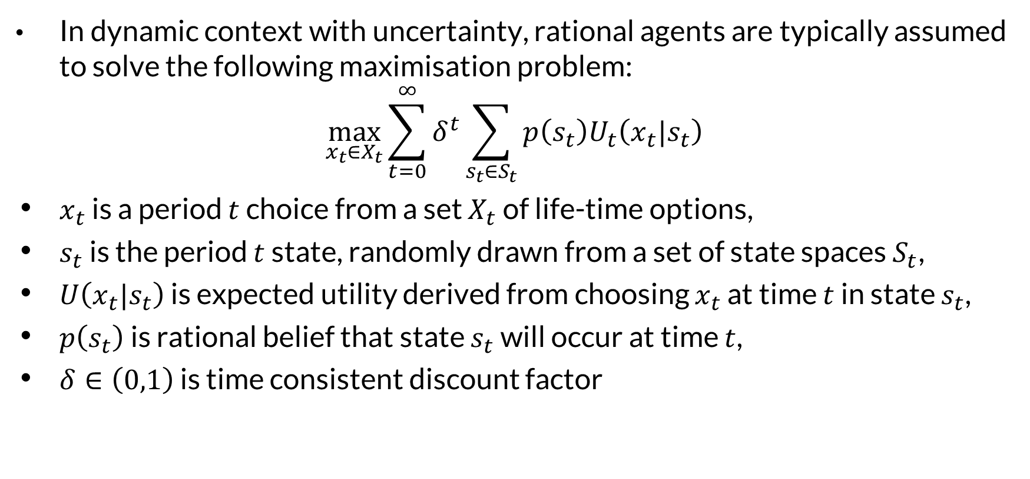
Prototypical model of rational agent
In dynamic context with uncertainty, rational agents are typically assumed to solve the following maximisation problem:
$$\max_{x_{t}∈X_{t}}{\sum_{t=0}^{∞}{δ^{t}\sum_{s_{t}∈S_{t}}{p\left(s_{t}\right)U_{t}\left(x_{t}|s_{t}\right)}}}$$
$x_{t}$ is a period $t$ choice from a set $X_{t}$ of life-time options,
$s_{t}$ is the period $t$ state, randomly drawn from a set of state spaces $S_{t}$,
$U\left(x_{t}|s_{t}\right)$ is expected utility derived from choosing $x_{t}$ at time $t$ in state $s_{t}$,
$p\left(s_{t}\right)$ is rational belief that state $s_{t}$ will occur at time $t$,
$δ∈\left(0,1\right)$ is time consistent discount factor

Slide 11
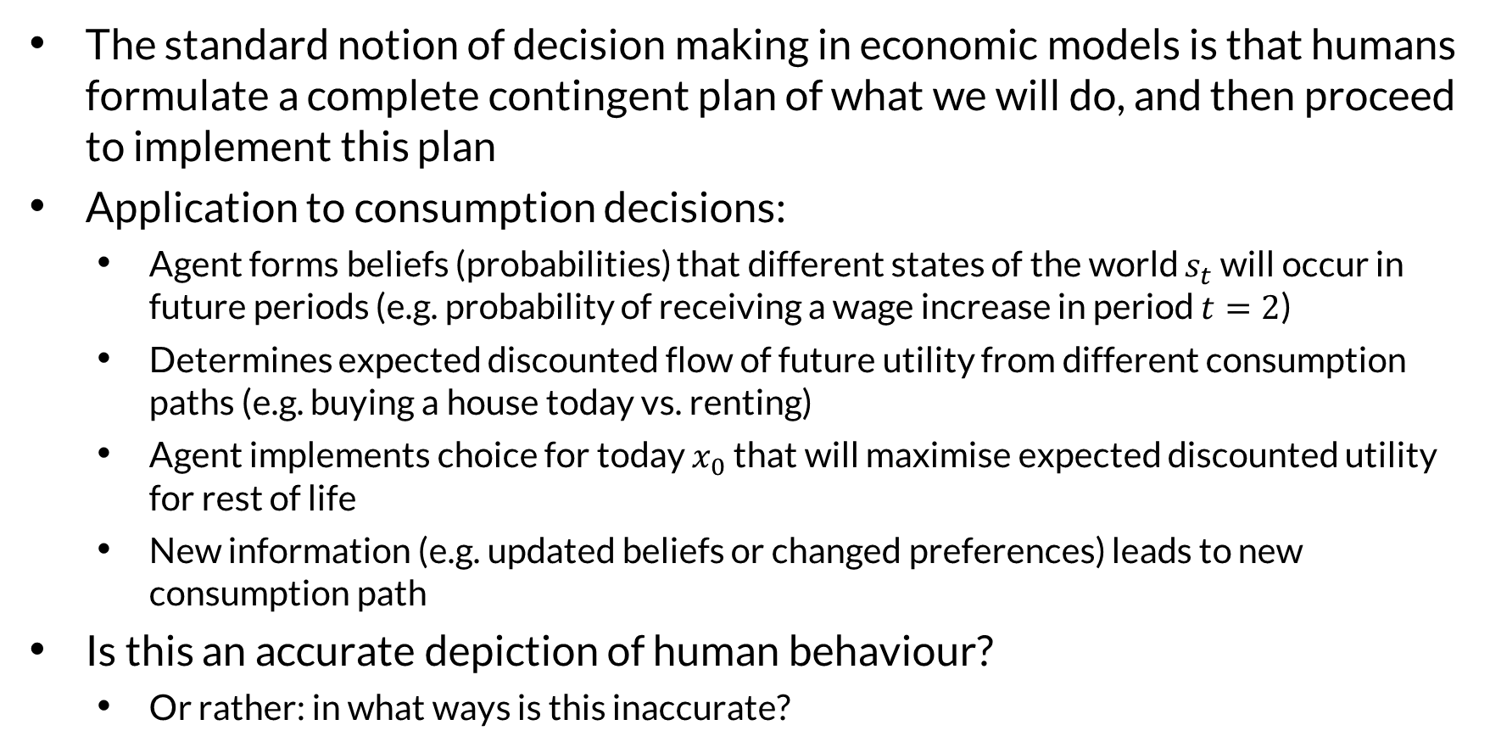
Prototypical model of rational agent
The standard notion of decision making in economic models is that humans formulate a complete contingent plan of what we will do, and then proceed to implement this plan
Application to consumption decisions:
Agent forms beliefs (probabilities) that different states of the world $s_{t}$ will occur in future periods (e.g. probability of receiving a wage increase in period $t=2$)
Determines expected discounted flow of future utility from different consumption paths (e.g. buying a house today vs. renting)
Agent implements choice for today $x_{0}$ that will maximise expected discounted utility for rest of life
New information (e.g. updated beliefs or changed preferences) leads to new consumption path
Is this an accurate depiction of human behaviour?
Or rather: in what ways is this inaccurate?

Slide 12
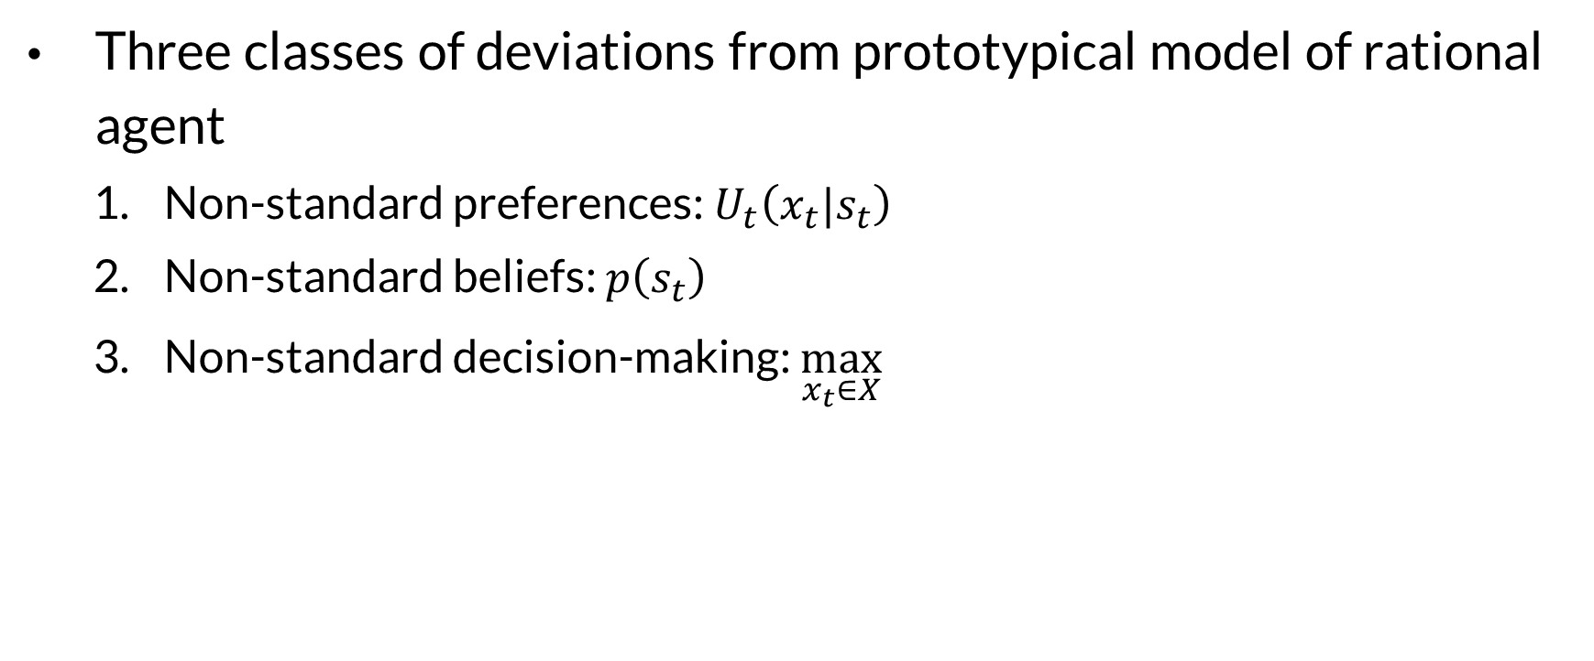
Behavioural economics
Three classes of deviations from prototypical model of rational agent
Non-standard preferences: $U_{t}\left(x_{t}|s_{t}\right)$
Non-standard beliefs: $p\left(s_{t}\right)$
Non-standard decision-making: $\max_{x_{t}∈X}$
Notes:
This follows taxonomy of Rabin (2002) and DellaVigna (2009)

Slide 13
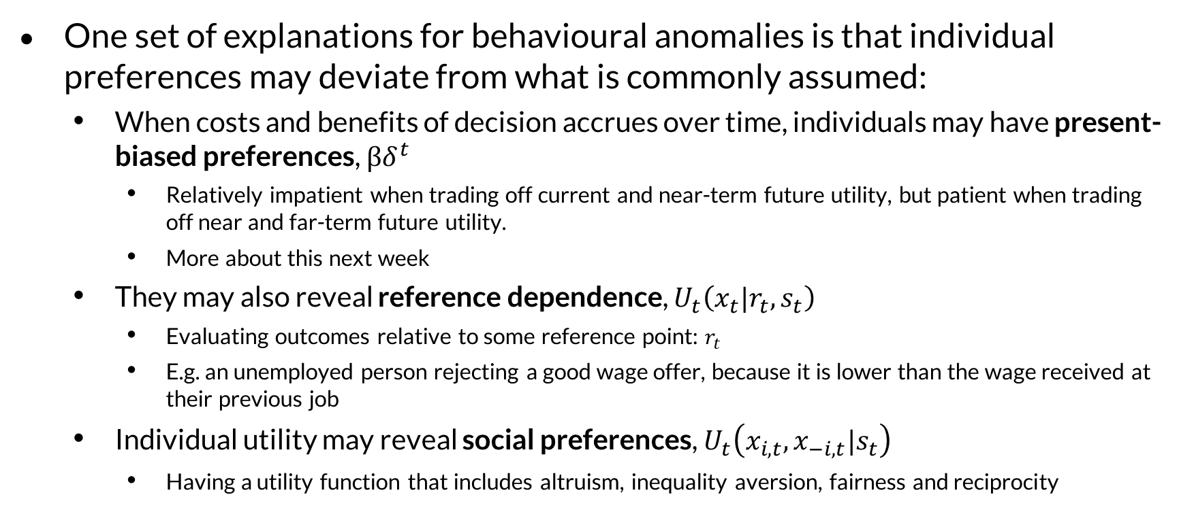
Non-standard preferences
One set of explanations for behavioural anomalies is that individual preferences may deviate from what is commonly assumed:
When costs and benefits of decision accrues over time, individuals may have present-biased preferences, $βδ^{t}$
Relatively impatient when trading off current and near-term future utility, but patient when trading off near and far-term future utility.
More about this next week
They may also reveal reference dependence, $U_{t}\left(x_{t}|r_{t},s_{t}\right)$
Evaluating outcomes relative to some reference point: $r_{t}$
E.g. an unemployed person rejecting a good wage offer, because it is lower than the wage received at their previous job
Individual utility may reveal social preferences, $U_{t}\left(x_{i,t},x_{−i,t}|s_{t}\right)$
Having a utility function that includes altruism, inequality aversion, fairness and reciprocity
Notes:
Hyperbolic discounting = people make decisions that they regret for immediate gratification which violates their LR preferences. Not the same as being impatient
Arbitrary reference points determine how we feel about things: reject wage offers lower than previous wages (so high wage in first job may be a curse); initially happy about 10% wage increase, until you learn that colleague received 12% increase.
Fairness: Thaler’s podcast story about someone cutting in line

Slide 14
Non-standard beliefs
A second set of deviations occur because people form beliefs about future utility and states of the world that deviates from rational expectations
People tend to:
have misplaced confidence in precision of beliefs (overconfidence);
overestimate own performance (particularly relative to others);
not anticipate predictable changes in their preferences (projection bias);
be too hasty in generalising from a small sample (law of small numbers);
excessively update beliefs based on personal experiences (experience effects);
have biased expectation (wishful thinking or defensive pessimism)
Also possible that beliefs may directly affect utility (belief-based preferences)
Notes:
Wishful thinking example: people who know that genetically they have 50% of having Huntingdon’s disease appear to (consciously or subconsciously) manipulate this belief to 0%.
Over-estimating own performance seems to be a particularly male trait
Projection bias includes an:
under-appreciation of habit formation = temporarily increase consumption - e.g. use an expensive coffee maker - and then surprised by how difficult it is to scale back down
hedonic adaptation = thinking that winning the lottery will make you eternally happy, but then quickly growing accustomed with your new lifestyle
intrapersonal empathy gap = under-estimate effect of temporary visceral state on decisions (overshopping when hungry, buying winter clothes when cold, underpacking for cold climate when hot)
Law of small samples include the gambler's fallacy, which is the mistaken belief that if something happens more frequently than normal during some period, it will happen less frequently in the future

Slide 15
Non-standard decision-making
Decision making sometimes deviates from utility maximisation, such as when:
people ignore choices that do not come to mind when making a decision (limited attention effect);
decisions are affected by the inclusion of irrelevant alternatives (menu effect);
people mentally partition expenses into different accounts in a way that affects decisions (mental accounting);
decisions are affected by advertising, promotions or political campaigns beyond the effect of such campaigns on information or prices (persuasion);
decisions are affected by emotions such as regret, envy or fear;
maximising “decision utility” is not the same as maximising happiness, life satisfaction or “experienced utility”
Notes:
Limited attention particularly severe for those living in poverty
Menu effect example: real estate agent who keeps bad property on portfolio so other properties will seem more attractive
Mental accounting: losing movie ticket makes you less inclined to still attend movie than losing equal amount of money (from general rather than entertainment account)
Decision utility: make decisions based on maximising career earnings, while underweighting aspects that provide life satisfaction (e.g. holidays with family)

Slide 16
Two system thinking
Many contemporary models of cognition conceive of mind as composed of two different sets of processes
Idea has many intellectual precursors: Plato, Freud, Adam Smith
More recently, social and cognitive psychologists have conceptualised the human brain as if functioning as two specialised processes
Kahneman (2011) popularised labels of System 1 and System 2
Neurological studies are confirming that these two processes occur in different parts of the brain
Notes:
Plato’s Charioteer anology: Charioteer driving a chariot pulled by two winged horses: "one of the horses is noble and of noble breed, but the other quite the opposite in breed and character. Therefore in our case the driving is necessarily difficult and troublesome.“ The Charioteer represents intellect, reason, or the part of the soul that must guide the soul to truth; one horse represents rational or moral impulse or the positive part of passionate nature; while the other represents the soul's irrational passions, appetites, or concupiscent nature. The Charioteer directs the entire chariot/soul, trying to stop the horses from going different ways, and to proceed towards enlightenment.
Freud’s structural model of the psyche: the id is the set of uncoordinated instinctual trends; the super-ego plays the critical and moralizing role; and the ego is the organized, realistic part that mediates between the desires of the id and the super-ego.
Adam Smith referred to struggle between our “passions” and “impartial spectator”

Slide 17

Two system thinking
24 x 17 = ?
Notes:
Picture = people instinctively notice that face is mad. Maybe you even anticipate what he will say and how he will sound
24 x 17 = 408.
When engaging system 2 pupils dilate, heart rate increases and you burn energy

Slide 18
System 1 and System 2
System 1 is fast, instinctual, emotional and unavailable for conscious introspection
It works automatically, with no or little effort or conscious control
Essential for recognising safe foods, avoiding dangerous animals, and behaving appropriately in social situations
System 2 is slower, deliberate and logical
It allocates attention and energy to certain cognitive activities, such as complicated calculations
Activating it dilates the pupils, increase heart rate and burns energy
In most cases these two systems function together efficiently
Problematic when some decisions are made by inappropriate system
Notes:
Examples of migrations: Chess master perceives strengths / weaknesses of chess positions instantly; pattern recognition has replaced effortful serial processing; Prolonged cultural exposure eventually produces a facility for social judgements, i.e. recognise personality descriptions as representative of certain occupation

Slide 19
Two system thinking
System 1 | System 2
Fast | Slow
Associative | Analytic
Automatic | Voluntary
Subconscious | Conscious
Effortless | Costly
Parallel | Serial

Slide 20
Visual perception
One example of System 1’s automatic activities is to make sense of visual inputs, according to which distant objects appear smaller
This usually works well, but can lead to optical illusions / biases
The Ponzo illusion tricks the brain into thinking an object on a 2D picture is larger than it is by placing it towards vanishing point (in 3D perspective)

Slide 21
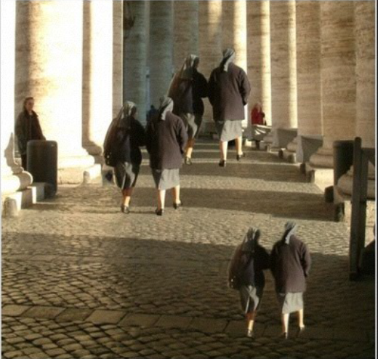

Slide 22
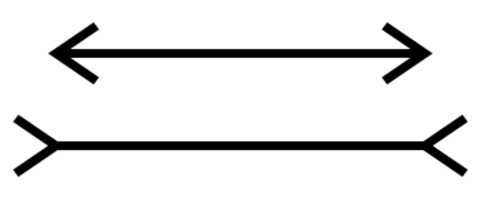
The Müller-Lyer effect

Slide 23
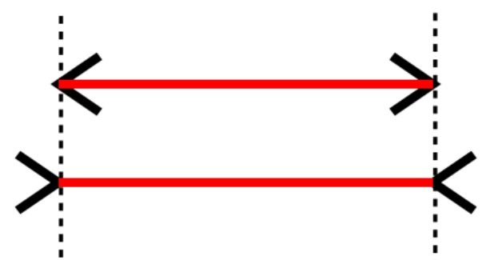
The Müller-Lyer effect

Slide 24
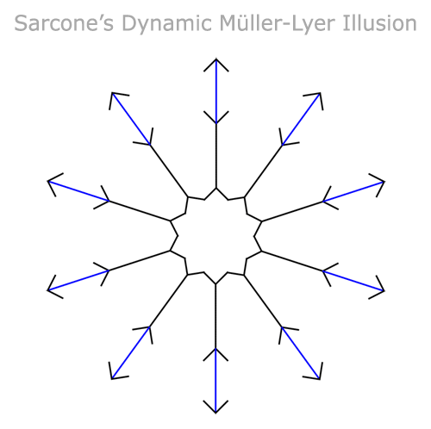
The Müller-Lyer effect

Slide 25
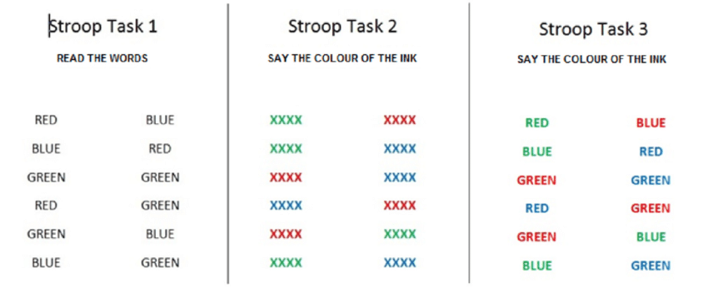
Notes:
Although mistakes are rare, the third Stroop task requires more cognitive effort and takes longer than other tasks

Slide 26
Two system thinking
Stroop task 3 illustrates this two-system structure:
Word is automatically read while inspecting its colour, and this happens more quickly than colour is identified
This activates response which needs to be actively suppressed
Errors are rare, but conflict produces delays and hesitations
Successful suppression is effortful and its efficacy is reduced by stress and distraction

Slide 27
Cognitive reflection test: Q1
A bat and a ball cost $1.10 together
The bat costs $1 more than the ball
How much does the ball cost?
Notes:
First described by psychologist Shane Fredrerick (2005). Ball is 5c, bat is R1.05c

Slide 28
Cognitive reflection test
When it comes to judgments or decisions System 1 will often propose a quick assessment of situation or stimulus, which System 2 can either endorse or override
During cognitive reflection test System 1 proposes an incorrect answer
If system 2 is too lazy or busy to check this answer, it will be endorsed as final answer
This combined failure of Systems 1 and 2 leads to cognitive error and can induce behavioural biases more generally
Frederick (2005) refers to the willingness to engage system 2 as cognitive reflection

Slide 29
Cognitive reflection test : Q2
It takes 5 machines 5 minutes to make 5 widgets
How long would it take 100 machines to make 100 widgets?
Notes:
System 1 recognises pattern and suggests 100 minutes, but answer is 5 minutes, since each machine produces 1 widget every 5 minutes

Slide 30
Cognitive reflection test : Q3
In a lake, there is a patch of lily pads
Every day, the patch doubles in size
If it takes 48 days for the patch to cover the entire lake, how long would it take for the patch to cover half of the lake?
Notes:
Tempting to say 24 days, but answer is 47 days

Slide 31
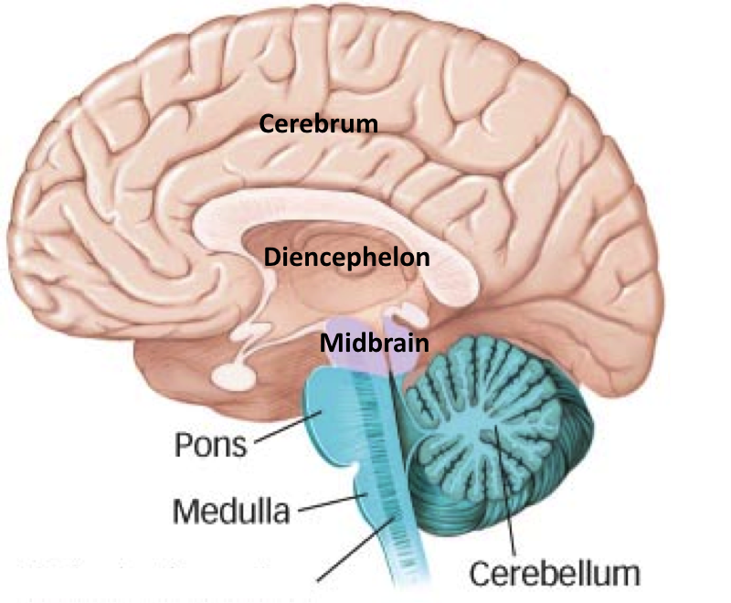
Neuroanatomy
The human brain consists of three main divisions:
forebrain (or prosencephalon)
midbrain (mesencephalon)
hindbrain (rhombencephalon)
The forebrain consists of two sub-divisions:
cerebrum (or telencephalon)
diencephalon (sometimes called the anterior forebrain)
The cerebrum consists of two sub-divisions:
cerebral cortex (grey matter), mainly consisting of the neocortex
subcortical structures (white matter)
Notes:
Source: various, including Wikipedia

Slide 32
MacLean’s Triune Brain model
In 1960s Paul MacLean classified brain complexes by stages of evolutionary development
The reptilian brain (represents will or “gut”)
Consists of hindbrain + most of midbrain
Controls the body's vital survival functions such as heart rate, eating, breathing, body temperature and balance
The mammal brain (or paleomammalian complex or limbic system) (represents emotions or “heart”)
Includes parts of the midbrain, diencephalon, subcortical structures and cerebral cortex
Supports a variety of functions including emotion, motivation, memory formation, and olfaction (smells & taste)
Responsible for social and nurturing behaviours, mutual reciprocity and recording memories of behaviours that produced agreeable and disagreeable experiences
The hominid brain (or neocortex) (represents rationality or “head”)
Includes much of cerebral cortex
Responsible for advanced cognition, such as language, consciousness and long-term planning
It is now understood that this model is oversimplified and technically inaccurate, but still offers a useful organising theme for different brain function and anatomical approximation for brain complexes

Slide 33
Neuroeconomics
Neurological studies increasingly allow us to link behaviour to brain activities
Dual-process cognitive model seems to be supported by fMRI scans that show two different parts of the brain working when considering problems in which systems 1 and 2 are in conflict:
Dopamine rewards system (DRS) = System 1
Pre-frontal cortex (PFC) = System 2

Slide 34
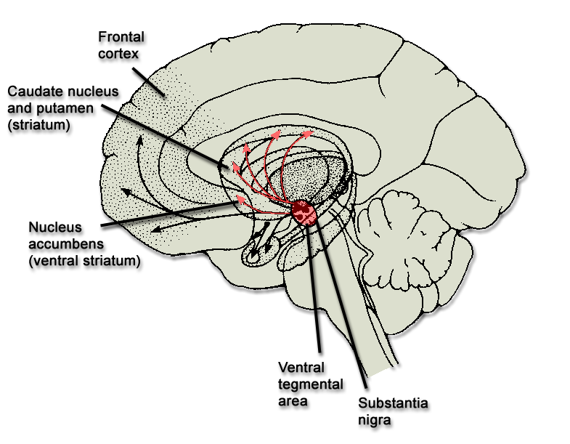
System 1 vs. System 2
Dopamine
reward system

Slide 35
Dopamine reward system
Pathways that produce and deliver the neurotransmitter dopamine for pain relief or pleasure
Other names: mesolimbic pathway, limbic system, bassa ganglia
Main sub-regions:
Ventral tegmentental area & substantia nigra (in the midbrain)
This produces the neurotransmitter dopamine for pain relief or pleasure
Striatum: ventral striatum (mainly the nucleas accumbens) & dorsal striatum (caudate nucleus and putamen)
Encodes values of goods consumed or chosen, and sends feedback to ventral tegmental area
Frontal cortex: mainly medial and orbital regions of frontal cortex
Communicates information to striatum, and receives information from ventral tegmental area
Hippocampus
Important in creating and storing memories
Amygdala
Fear occurs with activation of the amygdala
Other components
Globus pallidus, ventral pallidum, anterior cingulate cortex, insular cortex, hypothalamus
Dopamine plays a role in excitation, motivation and habituation of species from humans to insects
Notes:
Other names: depends on whether brain is defined anatomically or functionally
Esp substantia nigra pars reticulata

Slide 36
Prefrontal cortex
More recently developed and larger in humans than in other animals
Higher cognitive faculties, including deliberative thought, abstract reasoning, problem solving, planning and language all rely heavily on brain structures in the PFC
At the broadest level, two categories of function can be ascribed to prefrontal cortex: reasoning abilities and the capacity for cognitive control—that is, the ability to guide thought and action in association with abstract goals or intentions, especially when this requires overcoming countervailing habits or reflexes
Parts of the brain implicated in rational decision making
Anterior (frontopolar) prefrontal cortex
Working memory, multi-task coordination, executive control
Dorsolateral prefrontal cortex
Undergoes prolonged period of maturation, which lasts until adulthood
Planning, inhibition, abstract reasoning, risky and moral decision making
Posterior parietal cortex:
mediates mental representation of relative quantities
supports attentional function during number processing

Slide 37
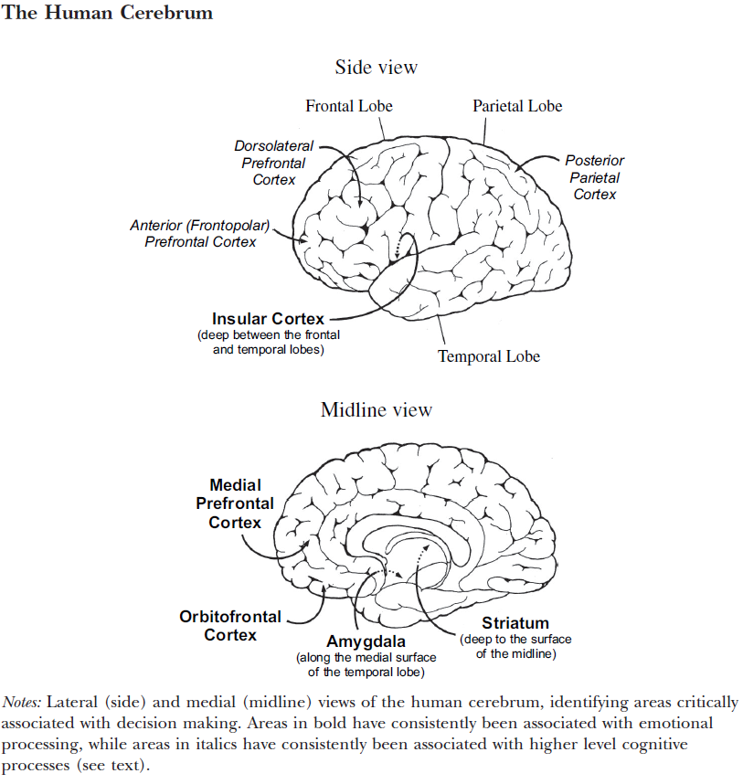

Slide 38
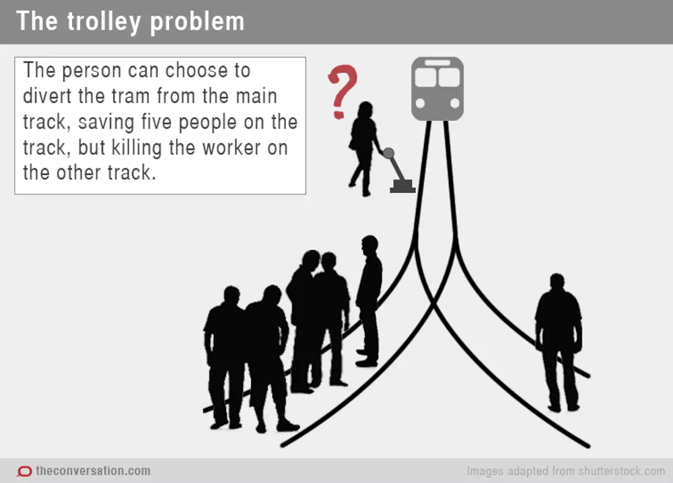
Notes:
A trolley is heading down a track on which there are five railroad workers, who cannot get off the track. They will be killed if nothing is done.
Switch scenario: You are an operator who can flip a switch to divert the trolley from its current track to a different track on which a single person is walking.
NB: The question is not what you WOULD do but what you SHOULD do.

Slide 39
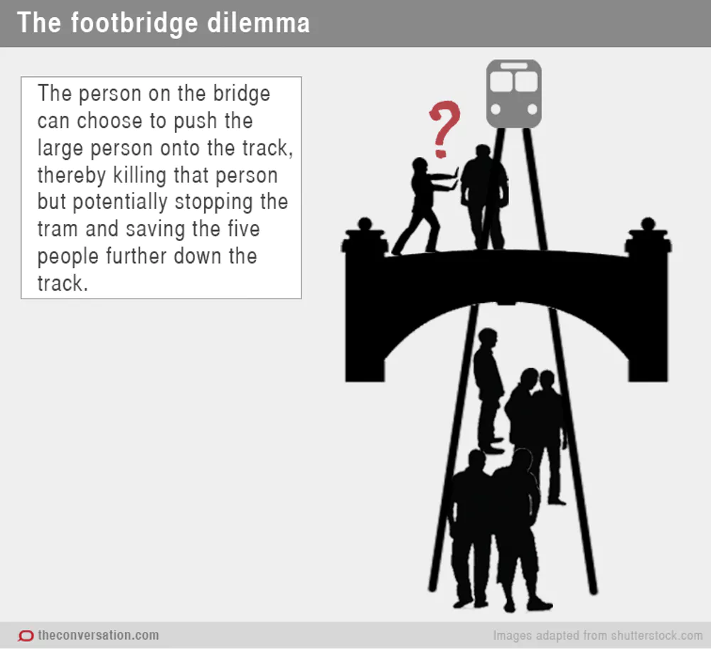

Slide 40
Trolley dilemma
Puzzle:
Most people think it is ethically justifiable to flip the switch (killing 1 person to save 5 lives), but not to push the large person off the footbridge
Philosophers and ethicist have proposed various rationalisations of different evaluations of “actuarially” identical scenarios
Neuroscientists found considering the different scenarios activated different parts of brain:
Switch scenario (which required inflicting harm at a distance) activated the PFC, whereas Footbridge scenario (which required nearby harm) activated DRS
Notes:
Incidental vs instrumental nature of death of single individual. But slight variation of switch scenario in which single death is instrumental is still deemed justifiable.
Neurologists have used brain imaging to “solve” trolley dilemma: pulling a lever effects violence far away (which until recently was impossible, and hence we have no evolutionary distaste for it), whereas pushing someone off a footbridge entails violence in less than a stone’s throw away (a distaste for which would have assisted our species in constructing stable communities and an evolutionary advantage)

Slide 41
Trolley dilemma
Cohen (2005) hypothesises that emotional aversion to harming other humans evolved to allow early humans to aggregate more effectively into stable social structures
However, this adaptation arose during time when scope for aggression was limited to a stone’s throw (literally); no evolutionary pressure to develop emotional aversion to harming others at greater distances
This (and other similar issues) important for policy researchers:
Social policies often meant to protect us from emotions that once served us well but can now interfere with our welfare
Notes:
Other examples: Rejecting low offers in ultimatum game corresponds to more activity in DRS and less in PFC
Same for choosing small immediate rewards over large delayed reward
Also activity in PFC appears to be relevant for effectiveness of placebos

